Slide 1
ASG Data Science Bootcamp
01.02.2022 – ASG Analytics TC Community

Slide 2

Supervised Machine Learning
Sahana Krishna Murthy, Neslihan Keskin

Slide 3

AGENDA
PART 1
Introduction to Supervised Learning
Regression modeling
Linear Regression
Regression trees
Evaluation metrics
MAE, MSE, RMSE
R^2 Error, Adjusted R^2 Error
LAB – Regression Model Building & Evaluation
PART 2
Data Balancing – Under & Over sampling
Fundamental classification modeling
Logistic Regression
KNN
Naïve Bayes
Decision trees
Evaluation metrics
Confusion Matrix
Accuracy, Precision, Recall, F1 Score, ROC, AUC
LAB – Classification Model Building & Evaluation

Slide 4
PART 1

Slide 5
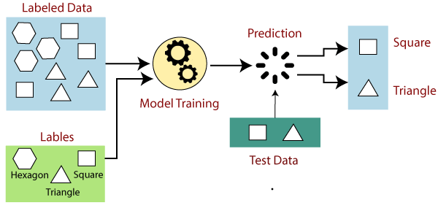
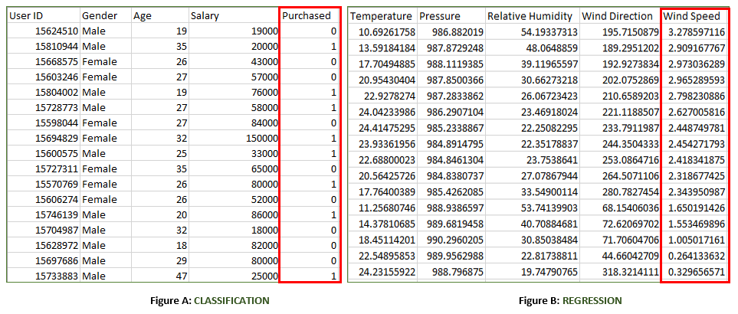
Introduction to Supervised Machine Learning
Definition: Supervised Machine Learning is an algorithm that learns from labeled training data to help you predict outcomes for unforeseen data.
Usage: Image classification, Fraud Detection, spam filtering etc..
Categories:
How it works:
The algorithm takes a known set of input data and known responses to the data (output) and trains the model.
Based on the training, the model generates reasonable predictions for the response to new data.
Regression
when the output variable is a real value, such as “dollars” or “weight”
Classification
when the output variable is a category, such as “Red” or “blue” , “disease” or “no disease”

Slide 6

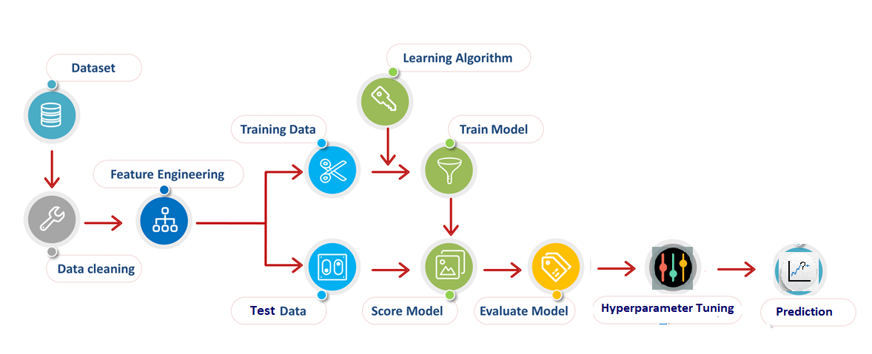

Machine Learning Process Flow

Slide 7
Regression analysis
Definition: Regression analysis is a statistical method to model the relationship between a dependent (target) and independent (predictor) variables.
Usage:
Regression estimates the relationship between the target and the independent variable.
It is used to find the trends in data.
It helps to predict real/continuous values.
Important Terminologies:
Dependent Variable: The main factor in Regression analysis which we want to predict or understand is called the dependent variable. It is also called target variable.
Independent Variable: The factors which affect the dependent variables, or which are used to predict the values of the dependent variables are called independent variable, also called as a predictor.
Multicollinearity: If the independent variables are highly correlated with each other than other variables, then such condition is called Multicollinearity. It should not be present in the dataset, because it creates problem while ranking the most affecting variable.

Slide 8
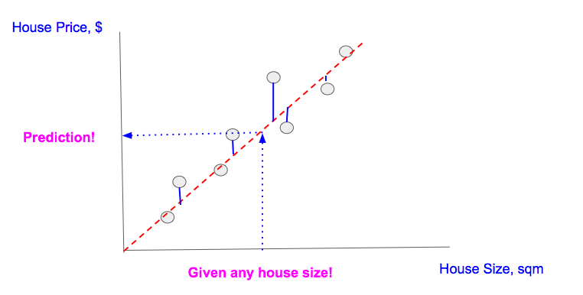
Linear regression - 1
Definition: Linear regression tries to model the relationship between a target variable and one or more independent variables by fitting a linear equation to the data.
Usage: Analyzing trends and sales estimates, Salary forecasting, Real estate prediction
Arriving at ETAs in traffic, etc..
Lab - https://towardsdatascience.com/assumptions-of-linear-regression-fdb71ebeaa8b
Assumptions:
Linear Relationship - relations between the independent (y) and dependent variables (x) must be linear
Independence of observations - no hidden relationships between observations
No multicollinearity – no or less correlation between independent variables
Normality - The residuals of the model are normally distributed

Slide 9
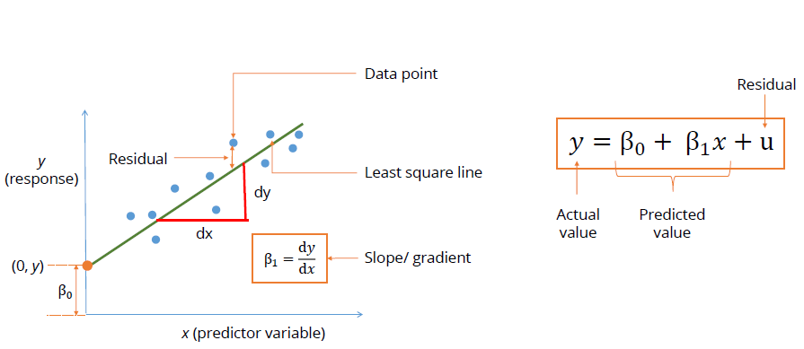
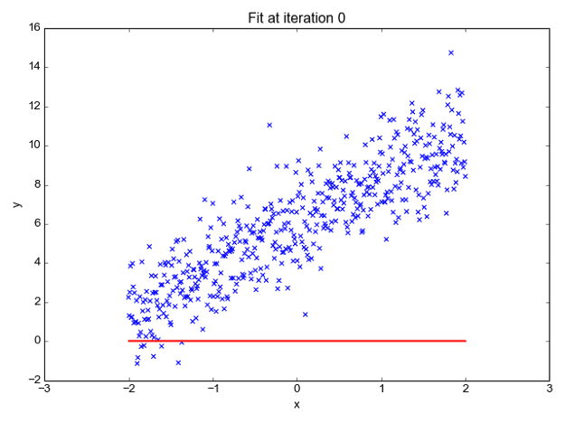
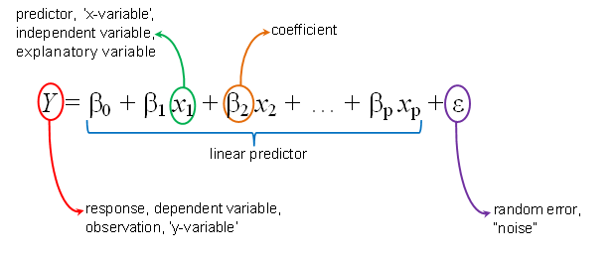

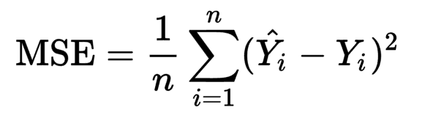
Linear regression - 2
How it works:
Line equation - y = mx +c
Best fit line -
The Cost Function – calculated by adding up the squared error terms
Gradient Descent - Optimization technique for finding minimum of cost function

Slide 10
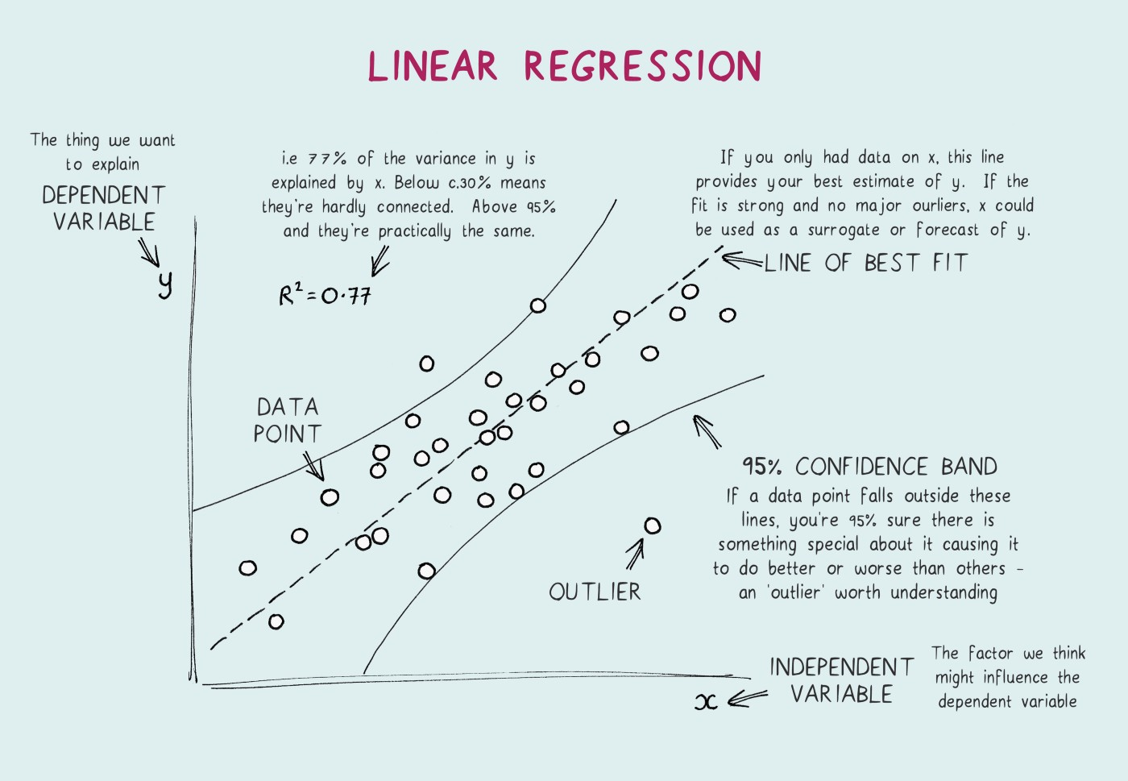
Regression trees - 1
Definition:
Usage:
How it works:

Slide 11
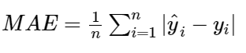
Regression Evaluation metrics - 1
What: An evaluation metric quantifies the performance of a predictive model.
How: Training a model on a dataset → Using the model to make predictions on test dataset not used during training → Comparing the predictions to the expected values in the test dataset.
Residual / error = actual value — predicted value
Evaluation metrics:
1. Mean Absolute Error(MAE)
Average of the absolute differences between the actual value and the model’s predicted value
Value range – 0 to 1
Smaller the value, greater the prediction power
Not preferred in cases where outliers are prominent
https://www.enjoyalgorithms.com/blog/evaluation-metrics-regression-models

Slide 12
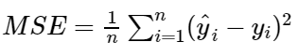
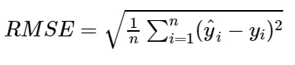
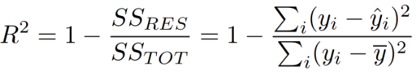
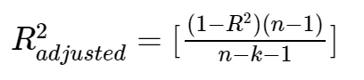
Regression Evaluation metrics - 2
2. Mean Square Error(MSE) / Root Mean Square Error(RMSE)
Average of the squared difference between the predicted and actual value → higher errors (or distances) weigh more
RMSE is used then to return the MSE error to the original unit by taking the square root of it, while maintaining the property of penalizing higher errors.
3. R Squared / Adjusted R Squared
R- squared explains the degree to which the input variables explain the variation of the output / predicted variable.
R Square value is between 0 to 1 and a bigger value indicates a better fit between prediction and actual value.
Adjusted R-square comes into the picture as it penalizes you for adding the variables which do not improve your existing mode.
where
n = total sample size
yi = actual value
Ŷi = predicted value
where
n = total sample size
p = number of predictors / columns

Slide 13
CASE STUDY – 1 (Regression)
Case Study overview -
Notebooks to refer –
Topics covered –
1. Regression Model building
2. Regression Model Evaluation

Slide 14
PART 2

Slide 15
Classification
Definition: Classification is the process of predicting the class of given data points. Classes are also called as targets/ labels or categories.
Binary Classifier: If the classification problem has only two possible outcomes. Examples: YES or NO, MALE or FEMALE, SPAM or NOT SPAM, CAT or DOG, etc.
Multi-class Classifier: If a classification problem has more than two outcomes. Example: Classifications of types of crops, Classification of types of music.
Usage:
Email spam detection (spam or not), Anomaly detection, Image classification, Sentiment analysis
Types of Learners:
Lazy Learners: Lazy Learner firstly stores the training dataset and wait until it receives the test dataset. In Lazy learner case, classification is done based on the most related data stored in the training dataset. It takes less time in training but more time for predictions. Example: K-NN algorithm, Case-based reasoning
Eager Learners: Eager Learners develop a classification model based on a training dataset before receiving a test dataset. Opposite to Lazy learners, Eager Learner takes more time in learning, and less time in prediction.
Example: Decision Trees, Naïve Bayes, ANN.

Slide 16
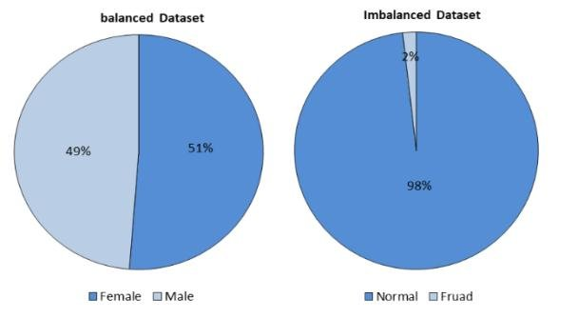
Data Balancing techniques - 1
Need for Balanced dataset: Let’s say you are working in a leading tech company and company gave you a task to train a model on detecting the fraud detection. But here’s the catch. The fraud transaction is relatively rare;
You start to training you model and get over 95% accuracy. But when company gives inputs to your model, the model is predicting “Not a Fraud Transaction” every time.
Reason: If the dataset is biased towards one class, an algorithm trained on the same data will be biased towards the same class.
Tactics To Combat Imbalanced Training Data:
Collect More Data
Changing Performance Metric
Resampling the Dataset
Over-Sampling → Add copies of instances from the minority class
Under-Sampling → Delete instances from the majority class
Generate Synthetic Samples – e.g., SMOTE
Try Different Algorithms – Like Random forest, Decision trees

Slide 17
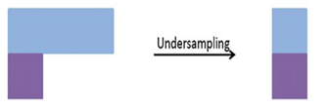
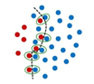
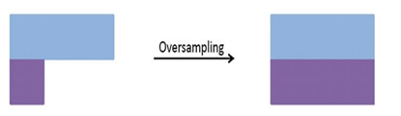
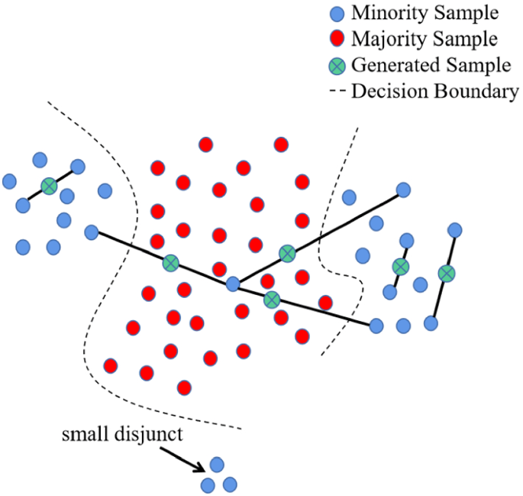
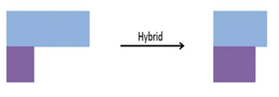
Data Balancing techniques - 2
Random Under-Sampling: It randomly selects the samples of the majority label(s) then removes them as much as the samples of the minority label.
Tomek Link: Tomek Link means the samples belong to different classes and are each other’s nearest neighbors. It removes overlapping Tomek Link from the data.
3. Random Over-Sampling: It randomly selects the samples of minority label(s) then duplicates them as much as the samples of majority label.
4. Synthetic Minority Over-sampling Technique (SMOTE): It is based on the K Nearest Neighbors by Euclidean Distance among the samples then generates the new samples within the distance.
5. Adaptive Synthetic (ADASYN): An alternative of SMOTE that uses the weighted distribution for various minority classes, which are based on their level of difficulty in learning
6. SMOTE + Tomek Link: It performs over-sampling (SMOTE) and under-sampling (Tomek Link) together.

Slide 18
Logistic Regression - 1
Definition: Logistic regression is a classification algorithm. It is used to predict a binary outcome based on a set of independent variables.
Characteristics:
In Logistic Regression, we don’t directly fit a straight line to our data like in linear regression. Instead, we fit a S shaped curve, called Sigmoid, to our observations
Why the name Regression? - Logistic regression uses the same basic formula as linear regression but it is regressing for the probability of a categorical outcome.
Assumptions:
The dependent variable is binary
No or less multicollinearity between the predictor variables
Prefers large sample size
Cost function & Gradient Descent:
In the case of logistic regression, the cost function is called LogLoss (or Cross-Entropy) and the goal is to minimize the following cost function equation. Gradient descent is used for changing weights based on the loss function for each data point.

Slide 19
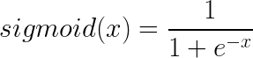
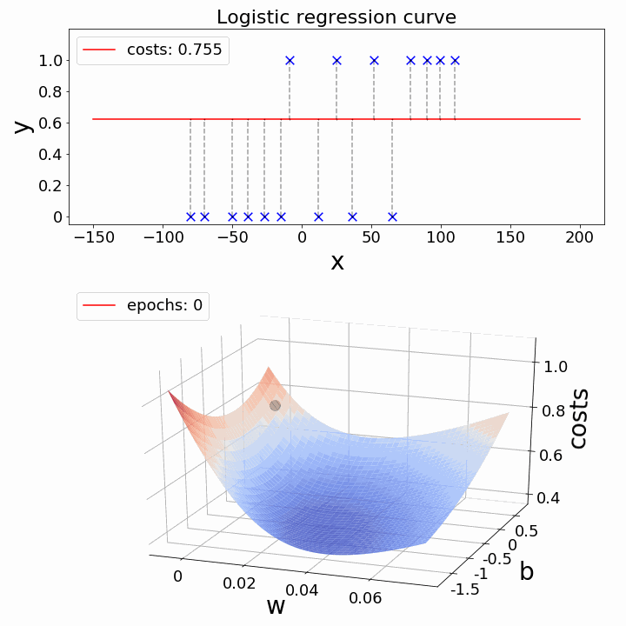
Logistic Regression - 2
Sigmoid Function – It’s an S-shaped curve that can take any real-valued number and map it into a value between 0 and 1
How it works:
Linear equation -> p = b0+b1x
Log Odds of probability (to get 0 & 1, tackle negatives) -> ln(p/(1-p)) = b0+b1x
To calculate p –> e^ln(p/(1-p)) = e^(b0+b1x)
So on... p = 1/ (1 + e-(b0+b1x1+b2x2+b3x3+----+bnxn)
Maximum-likelihood estimation - The coefficients (Beta values b) of the logistic regression algorithm must be estimated from your training data.
Decision boundary: A decision boundary is a threshold that we use to categorize the probabilities of logistic regression into discrete classes. A decision boundary could take the form:
y = 0 if predicted probability < 0.5 y = 1 if predicted probability > 0.5

Slide 20
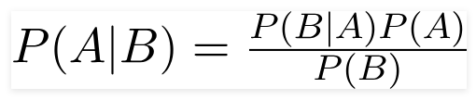
Naive Bayes - 1
Definition: The Naive Bayes method is a supervised learning algorithm based on applying Bayes’ theorem with the “naive” assumption of conditional independence between every pair of features given the value of the class variable
Usage: Sentiment analysis, recommendation systems, etc..
Assumptions:
1. Independent - We assume that no pair of features are dependent. For example, the temperature being ‘Hot’ has nothing to do with the humidity or the outlook being ‘Rainy’ has no effect on the winds. Hence, the features are assumed to be independent.
2. Equal - Each feature is given the same weight(or importance). For example, knowing only temperature and humidity alone can’t predict the outcome accurately. None of the attributes is irrelevant and assumed to be contributing equally to the outcome.
Bayes Theorem: Using Bayes theorem, we can find the probability of A happening, given that B has occurred. Here, B is the evidence and A is the hypothesis. The assumption made here is that the predictors/features are independent. That is presence of one feature does not affect the other. Hence it is called naive.

Slide 21
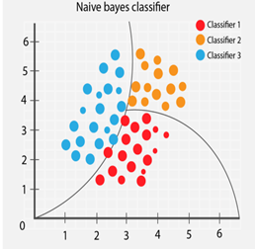
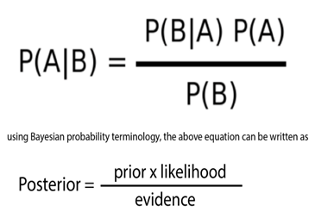
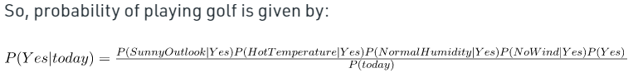
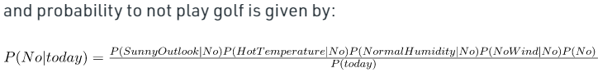
Naive Bayes - 2
How it works: It calculates the probability of each class and then pick the one with the highest probability.
Converts the given dataset into frequency tables
Generate Likelihood table by finding the probabilities of given features.
Uses Bayes theorem to calculate the posterior probability.
Example: today = (Sunny, Hot, Normal, False)
where
P(A|B) is Posterior probability: Probability of hypothesis A on the observed event B.
P(B|A) is Likelihood probability: Probability of the evidence given that the probability of a hypothesis is true.
P(A) is Prior Probability: Probability of hypothesis before observing the evidence.
P(B) is Marginal Probability: Probability of Evidence.

Slide 22
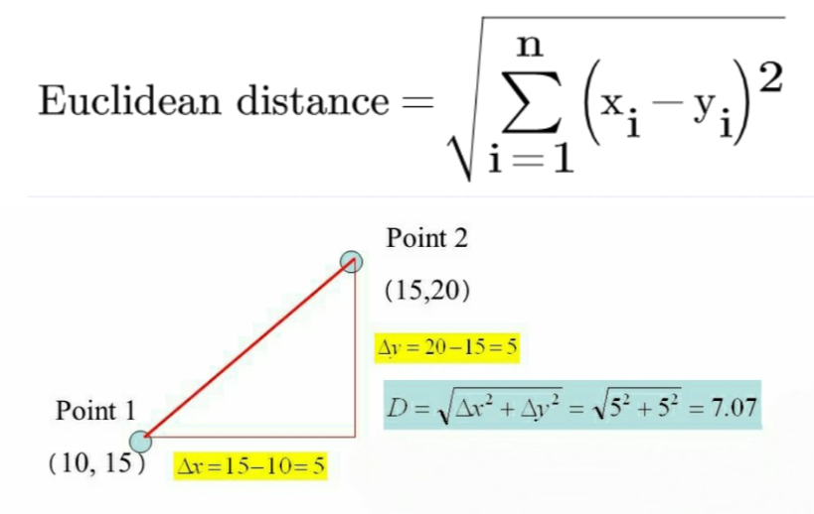
K Nearest Neighbours - 1
Definition: K-Nearest Neighbor is a classification and prediction algorithm that is used to divide data into classes based on the distance between the data points.
Assumptions:
It prefers smaller datasets (less sample size) and with less features (low dimensions)
Data points which are close to one another must be similar
Distance Metrics: To measure the distance between data feature values and new test inputs. Usually, we use the Euclidean approach.

Slide 23
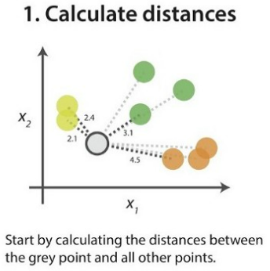
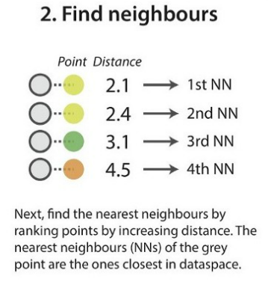
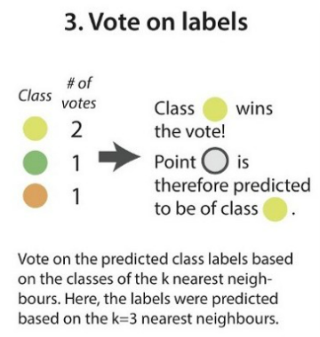
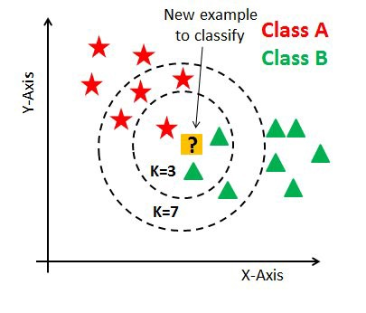
K Nearest Neighbours - 2
How it works: KNN works by finding the distances between a query and all the examples in the data, selecting the specified number examples (K) closest to the query, then votes for the most frequent label (in the case of classification) or averages the labels (in the case of regression).
Choosing K: K value indicates the count of the nearest neighbors.
K = sqrt(n) -- where n is number of samples
Error rate - Iteration of set of K values with least error
K value should be odd while considering binary(two-class) classification

Slide 24
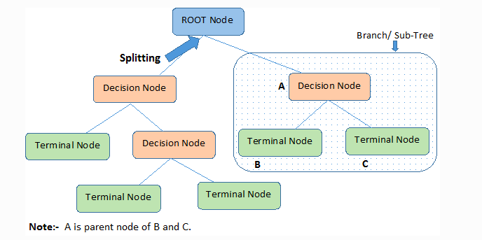
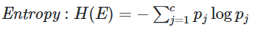
Decision Trees - 1
Definition: A Decision Tree is an algorithm that is used to visually represent decision-making. A Decision Tree can be made by asking a yes/no question and splitting the answer to lead to another decision.
Attribute Selection Measures:
Entropy - Entropy is a metric to measure the impurity in each attribute. It specifies randomness in data.
If a dataset contains homogeneous subsets of observations, then no impurity or randomness is there in the dataset, and if all the observations belong to one class, the entropy of that dataset becomes zero.
Important Terminologies:
Root Node: It represents the entire population or sample, which gets divided into two or more homogeneous sets.
Splitting: It is a process of dividing a node into two or more sub-nodes.
Decision Node: A sub-node that splits into further sub-nodes
Leaf / Terminal Node: Nodes that do not split
Branch / Sub-Tree: A subsection of the entire tree is called branch or sub-tree.

Slide 25
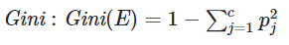
Decision Trees - 2
Information Gain:
To find the best feature which serves as a root node
It follows the concept of entropy while aiming at decreasing the level of entropy, beginning from the root node to the leaf nodes.
Information Gain = Entropy before splitting - Entropy after splitting
The feature having the highest value of information gain is accounted for as the best feature to be chosen for split.
3. Gini Index: It gives an idea of how good a split is by calculating the amount of probability of a specific feature that is classified incorrectly when selected randomly.
It measures the impurity of a node
A feature with a lower Gini index is chosen for a split
The degree of gini index varies from 0 to 1,
Where 0 = all the elements belong to only one class, 1 = all the elements are randomly distributed across various classes

Slide 26
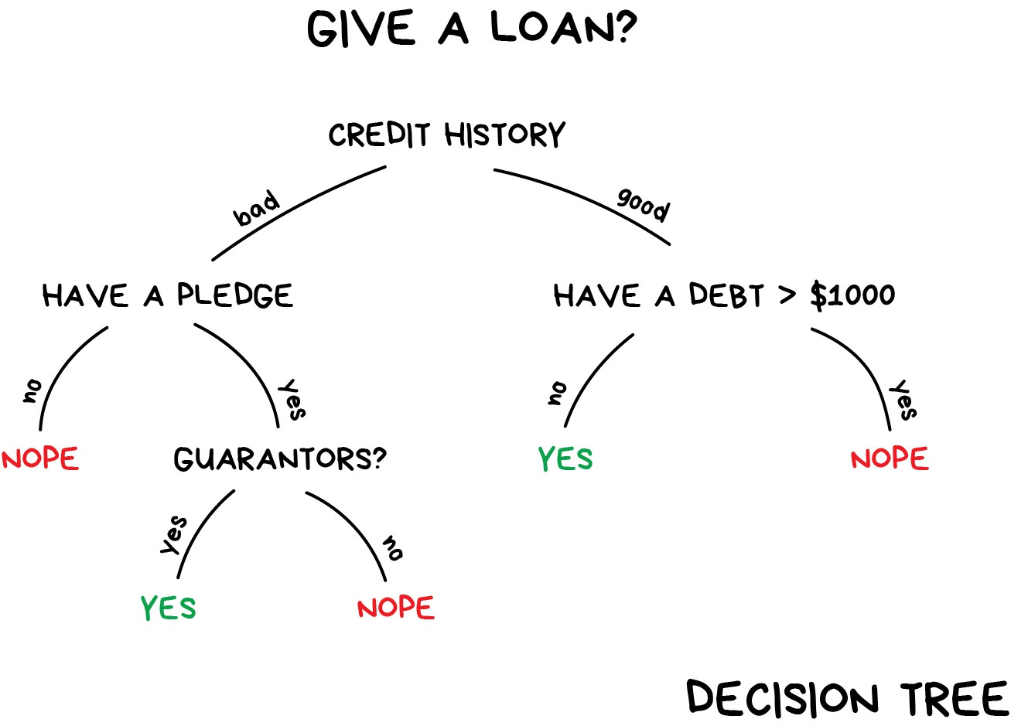
Decision Trees - 3
How it works: It utilizes the if-then rules which are equally exhaustive and mutually exclusive in classification. The process goes on with breaking down the data into smaller structures and eventually associating it with an incremental decision tree.
Steps:
Begins with the original set S as the root node.
Select the best attribute in the dataset using Attribute Selection Measure
Divide the S into subsets that contains possible values for the best attributes.
The algorithm continues to recur on each subset, considering only attributes never selected before.
Continue this process until a stage is reached where you cannot further classify the nodes and called the final node as a leaf node.
Pruning: Removing sub-nodes of a decision node that makes use of features having low importance
A too-large tree increases the risk of overfitting, and a small tree may not capture all the important features of the dataset. Therefore, a technique that decreases the size of the learning tree without reducing accuracy is known as Pruning

Slide 27
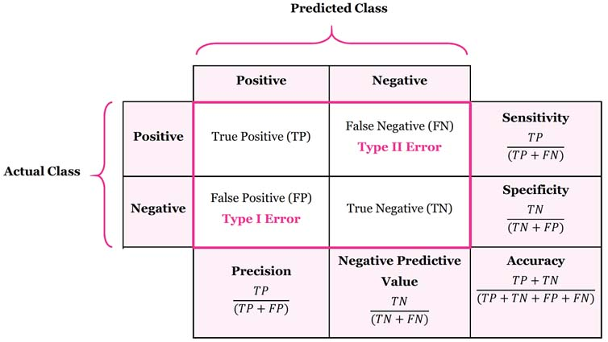
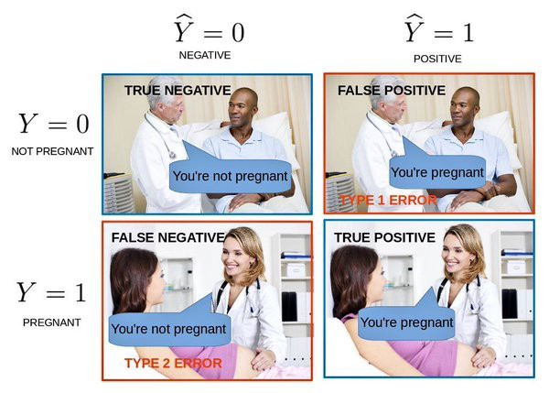
Classification Evaluation metrics - 1
Confusion matrix - A confusion matrix is a table that is often used to describe the performance of a classification model (or "classifier") on a set of test data for which the true values are known.
Example: Say we have a data of 1000 patients out of which 50 have cancer and 950 not, a basic model which always predicts as no cancer will have the accuracy of 95%, but it is of no practical use since in this case, we want the number of False Negatives as a minimum. Thus, we have different metrics like recall, precision, F1-score etc.

Slide 28
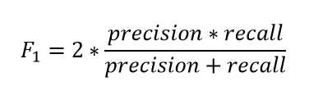
Classification Evaluation metrics - 2
1. Accuracy
Ratio of the number of correct predictions and the total number of predictions
It lies between [0,1] - Higher accuracy means a better model
When to use - For problems which are well balanced and not skewed or No class imbalance
2. Precision
Answers what proportion of predicted Positives is truly Positive
When to use - when we want to be very sure of our prediction
3. Recall
Answers what proportion of actual Positives is correctly classified?
When to use - when we want to capture as many positives as possible
4. F1 Score
F1 score is a number between 0 and 1 and is the harmonic mean of precision and recall
When to use – when we want to have a model with both good precision and recall
Conclusion: If you are a police inspector and you want to catch criminals, you want to be sure that the person you catch is a criminal (Precision) and you also want to capture as many criminals (Recall) as possible. The F1 score manages this tradeoff.

Slide 29
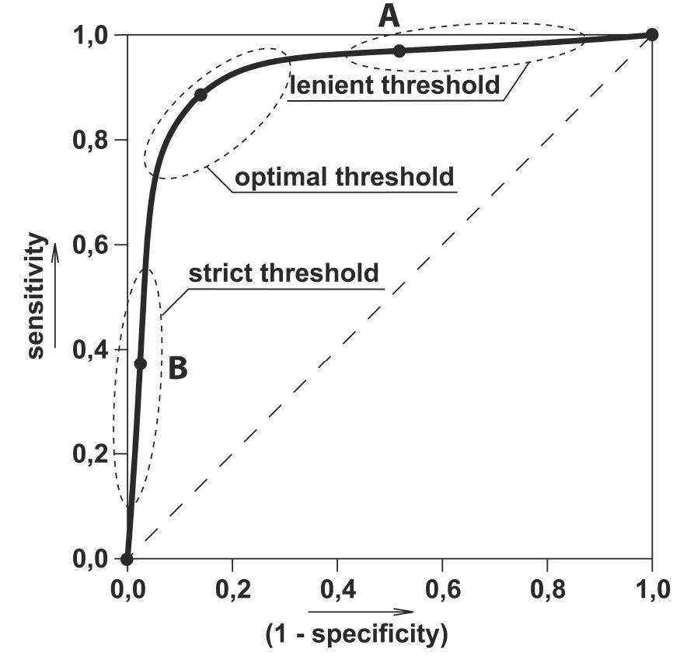
Classification Evaluation metrics - 3
5. ROC AUC
AUC (Area Under The Curve)- ROC (Receiver Operating Characteristics
AUC is the area under the ROC curve
AUC ROC indicates how well the probabilities from the positive classes are separated from the negative classes
Greater the AUC (0 to 1), better is the performance of the model
When to use – when predictions ranked by probability order is to be used
https://towardsdatascience.com/the-5-classification-evaluation-metrics-you-must-know-aa97784ff226

Slide 30
CASE STUDY – 2 (Classification)
Case Study overview -
Notebooks to refer –
Topics covered –
1. Handling Imbalanced dataset
2. Fundamental Classification Model building
2. Classification Model Evaluation

